Slide 1


ROCm on Gentoo
+
2021 TUNA OSPP Project: 完善 Gentoo ROCm GPGPU 框架
学生：武益阳
导师：续本达

Slide 2
What is Radeon Open Ecosystem (ROCm)?
Open -- open source
Ecosystem -- a bench of software and frame works
Radeon -- high performance computing on Radeon GPUs
AMD’s “cuda”ecosystem. Very similar to cuda for end users, since most of its API mimiate cuda’s for smooth porting, which means softwares written in cuda can be easily transfered to hip (Heterogenous compute Interface for Portability), and compiled to GPU kernels that runs on AMD GPU.
Ah ha, no pain to port my cuda code on AMD’s GPU! ROCm YES, OpenCL No!
But how many dark magic are hidden behind for this compability?

Slide 3
Deploying ROCm
ROCm is so nice. Let’s install!
https://rocmdocs.amd.com/en/latest/Installation_Guide/Installation-Guide.html : we only support ubuntu, RHEL series officially; we need dkms for AMDGPU which only works on certein versions of Linux kernel. rpm and deb packages provided, all install files in /opt/rocm. Want some customize? No root privilage? Want to try some new cards we don’t support? We are all open-sourced, so GO COMPILE IT YOURSELF!

Slide 4
Why ROCm on Gentoo
Its time to use Gentoo
All packages are compiled, can be custmized to fit for your device.
Installation location follow the Gentoo FHS (filesystem hierarchy standard).
Compatible with Gentoo Prefix, which means you can port it anywhere without root privilages.
Compatible with the newest Gentoo portage tree. Use the newest packages from Gentoo, as well as ROCm.
Don’t need dkms.

Slide 5
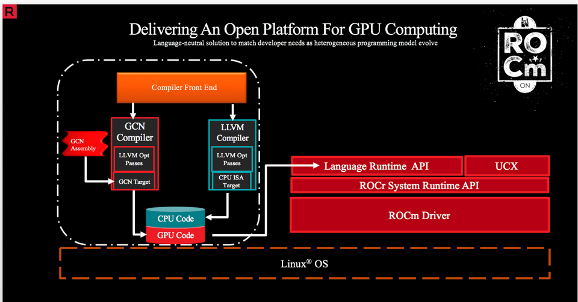
A closer look at ROCm base system

Slide 6
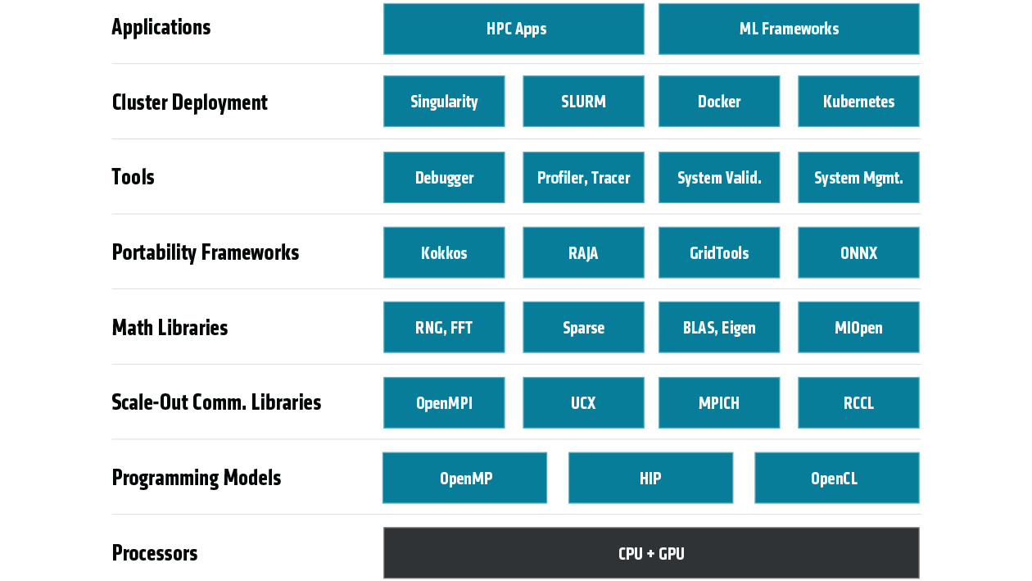
Our goal
Gentoo (Prefix)
Pytorch

Slide 7
What has been done
Pytorch
√
√
ready
PR
ready
√

Slide 8
How to try HIP
Complilation prerequisite: Gentoo or Gentoo Prefix, amd64 machine.
Runtime prerequisite : Linux kernel >= 5.13, or rock-dkms for AMDGPU kfd driver; Radeon GPU. Gentoo or Gentoo prefix. rw access to /dev/kfd
Using the latest portage tree, accept “~amd64” keyword.
to install hip complier:
emerge dev-util/hip
Runtime dependencies will also be installed.
Then you can compile hip program with hipcc (just like nvcc)
hipcc <source> -o <exe> (auto detect GPU arch)
hipcc --offload-arch=<specific gpu arch> <source> -o <exe>
Transfer cuda code to hip code:
hipify-perl source.cu > souce.hip

Slide 9
GPU architecture
https://llvm.org/docs/AMDGPUUsage.html#processors
Supported archs for HIP:
  gfx70[0-5] -- Sea Islands
  gfx80[1-35], gfx810 -- Volcanic Islands
  gfx90[024689a] -- Vega, CDNA1
  gfx101[0-2] -- RDNA1
  gfx103[0-2] -- RDNA2
Target feature for
  xnack for gfx9** and RDNA1 cards
  sramecc for gfx906, gfx908, gfx90a
  Auto detect GPU arch:
  emerge rocminfo
rocminfo | sed -n "s/.*amdgcn-amd-amdhsa--\(.*\)/\1/p"

Slide 10
How to try math libraries
Specify GPU architectures you want to compile to AMDGPU_TARGETS.
echo “AMDGPU_TARGETS=gfx906:xnack-;gfx908:xnack-;gfx1030” >> /etc/portage/make.conf
Install math libs:
emerge =sci-libs/rocBLAS-4.3.0
emerge =sci-libs/rocSPARSE-4.3.0
emerge =sci-libs/rocPRIM-4.3.0
emerge =sci-libs/rocSOLVER-4.3.0
rocFFT-4.3, rocRAND-4.3, rocThrust-4.3, hipSPARSE-4.3, hipCUB-4.3, hipFFT-4.3 are in PR, and will be ready soon. You can find their ebuild in https://github.com/littlewu2508/gentoo/tree/rocm4.3

Slide 11
How to install machine learning frameworks
MIOpen-4.3 is in https://github.com/littlewu2508/gentoo/tree/rocm4.3
Switch portage tree to this branch;
emerge =sci-libs/miopen-4.3.0
pytorch-1.9.1 is in https://github.com/littlewu2508/sci/tree/pytorch-1.9.1-rocm
Add science overlay and switch to this branch;
emerge =sci-libs/pytorch-1.9.1

Slide 12
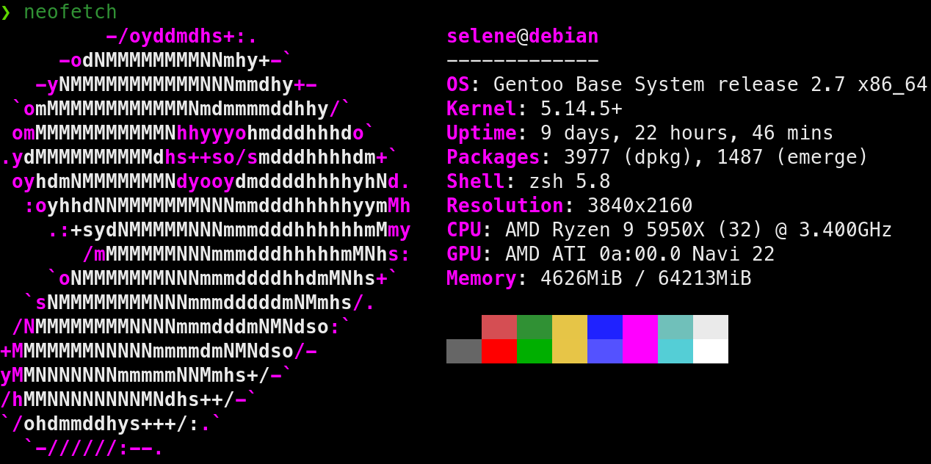
More to explore
Testing and benchmarking devices
Trying new cards (RX 6700XT works for me after some hacks: sed ‘s/gfx1030/gfx1031/g’)
Building more ROCm based packages

Slide 13

Thanks for listening!

